Slide 1
TempCNTL Simulation
Tulasi
Dec 3rd 2011

Slide 2
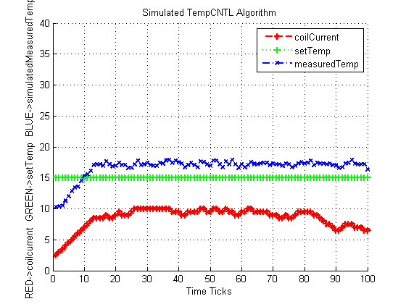
From a Low Temp to set temp

Slide 3
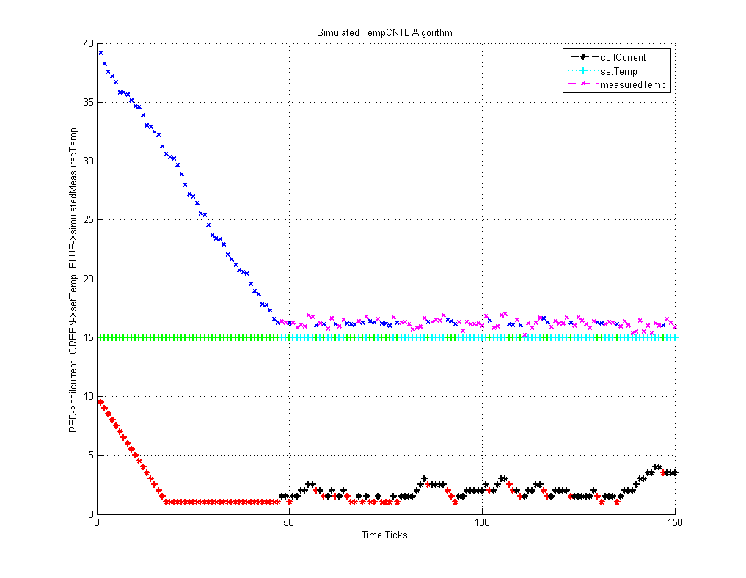
From a high temp to set temp

